Slide 1

I
Police Body Cameras
RSAK
DAVID KIARIE | POLICE BODY CAMERAS

Slide 2
II
01
WHY DO WE NEED POLICE BODY CAMERAS?
Key Objectives
At A Glance
02
THE SOURCING PROCESS
Key topics to cover in this presentation today.
03
ADOPTION OF POLICE BODY CAMERAS

Slide 3
PART ONE
III
What Are Body Cameras?
RSAK
In policing equipment, a body camera or wearable camera, also known as body-worn video (BWV), body-worn camera (BWC), or bodycam, is a wearable audio, video, or photographic recording system used by police to record events in which law enforcement officers are involved, from the perspective of the officer wearing it. They are typically worn on the torso of the body and pinned on the officer's uniform.
Body cameras are used by law enforcement to record their interactions with the public, or gather video evidence at crime scenes. Current body cameras are much lighter and smaller than the first experiments with wearable cameras as early as the late 1990s.

Slide 4
IV
Why Do We Need Body Cameras?
To help fight corruption and enhance transparency and accountability on our roads.
DAVID KIARIE | POLICE BODY CAMERAS

Slide 5
PART TWO
V
The Sourcing Process
RSAK
The Road Safety Association of Kenya conducted a selective sourcing process for several local companies that are known for their track records and can handle the sourcing process' complexity.
RSAK recommends using a suitable local company that enables employment opportunities for citizens, demonstrates adequate capacity to handle the body camera's complexity and has qualified personnel. RSAK reviewed the financial and quality elements of the suitable company against the marking criteria alongside the submissions of other shortlisted competitors.

Slide 6

VI
Sourcing Process Criteria
Local Company
Adequate Capacity
Qualified Personnel
The company must be owned by a Kenyan and have an 80% local workforce.
They must also have a track record of good conduct with the authorities.
The company has to demonstrate the financial capability to bring in the cameras.
They must have a central physical location for storage and adequately distributed branch locations.
The company must have local technicians who can be trained abroad.
The technicians should be able to train users, maintain and service the body cameras.

Slide 7
PART THREE
VII
Adoption of Police Body Cameras in Kenya
RSAK
Deputy Speaker of the National Assembly Gladys Boss Shollei on Monday November 7, 2022, proposed that police officers in the country should start wearing body cameras to tame rampant corruption. Appearing on TV, the lawmaker argued that the body-cam would enhance transparency and accountability within the service.
The National Police Service says it would not shy away from using body-worn cameras in efforts to improve efficiency and transparency. If adopted, Kenya would join growing list of countries that have embraced smart policing in the fight against crime and as a safety measure to protect the men and women in blue during operations.
FACT CHECK
Over Ksh. 800 million is lost every day to bribes on our roads. This money could be used to boost our economy .

Slide 8
Types of Body Cameras
VIII
Uses a sim card to operate the camera
01
Excellent for getting direct access to a specific body camera while in operation
SIM CARD OPERATED BODY CAMERAS
Very costly to maintain the body cameras due to airtime charges.

Slide 9
Types of Body Cameras
IX
VII
Uses a wi-fi connection to upload data from the camera to a server
02
Excellent for using in remote areas where sim card connection is not great
WI-FI OPERATED BODY CAMERAS
More affordable to use, operate and maintain

Slide 10
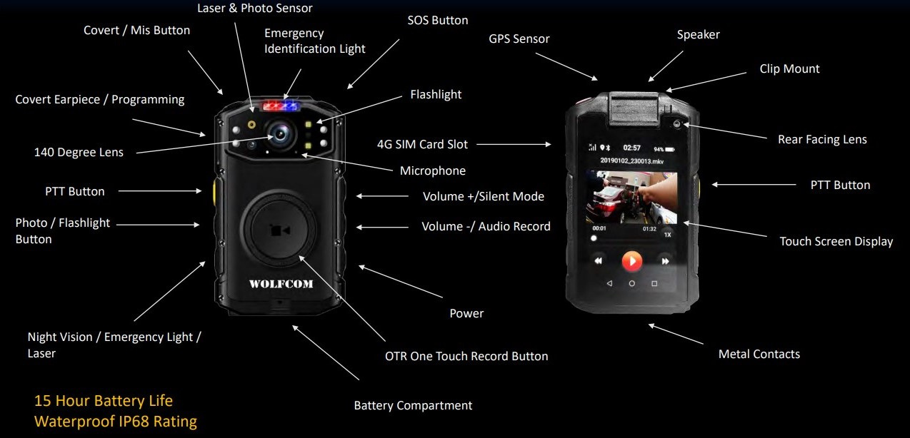
PARTS OF A POLICE BODY CAMERA
X
RSAK

Slide 11

Features of Body
Cameras
Weather-proof, rugged and durable cameras
Excellent video quality recording
Excellent sound quality in the videos
The cameras are impervious to water and hence can be used during the rainy seasons.
They can also withstand harsh weather conditions such as extreme sun and UV rays. They must also be dust-proof.
Video recording is the most important and fundamental function of body-worn cameras.
This highly sophisticated bodycam can even meticulously distinguish facial features and profiles very clearly at a distance of 5 to 10 meters in the dark.
The microphone attached to the camera is also hi-tech and capable of recording even the background noise.
The cameras can capture the conversation of bystanders in addition to the sound of the targeted situation.

Slide 12
Features of Body
Cameras
MetaData
Generation
High-Level Tracking and Monitoring
Cloud
Connectivity
The personal and transactional information of the user, device and the activities taking place related to an event or a case is called Metadata.
The date, time, duration, and location of the recorded events are also a part of the Metadata generated.
The body-worn cameras use servers to store the videos hence they can gather live evidence of events with the help of recorded video and audio.
It offers central management giving security personnel a complete view of happenings from a large number of cameras in a central control room.

Slide 13
Features of Body
Cameras
All-time Positioning Through Bodycam GPS
High-Level Data
Security
Compact Bodycam size & friendly User Interface
It supports outdoor positioning configurations, such as GPS, GLONASS and AGPS, and indoor Bluetooth positioning.
Even in places such as garages, tunnels and shopping malls, the location of frontline personnel can be tracked in real-time.
It adopts AES-256 encryption in the body-worn camera for high-level data security. The video is tamper-proof with automatic tags of time stamp, device ID, and user ID upon recording.
All footage recorded by the camera is encrypted and only accessible to authorized users.
It is lightweight and easy to understand the functionalities and how the camera operates.

Slide 14
Digital Evidence Management System Software
RSAK
Excellent Video Quality
Video quality is of good quality.
Secure Data Transfer
Compliant with transfer protocols such as WPA2, SFTP and STP.
Device Management
AES Encryption Key
Scan officer/user ID and camera serial number with a barcode scanner to book cameras out(assigned) and book in to automatically upload footage.
All recordings are encrypted via AES256.
DAVID KIARIE | POLICE BODY CAMERAS
Digital Signature
Controlled Access
We retain an encrypted master file of the original video and ensure its integrity using hash-based verification.
Password controlled access levels.

Slide 15
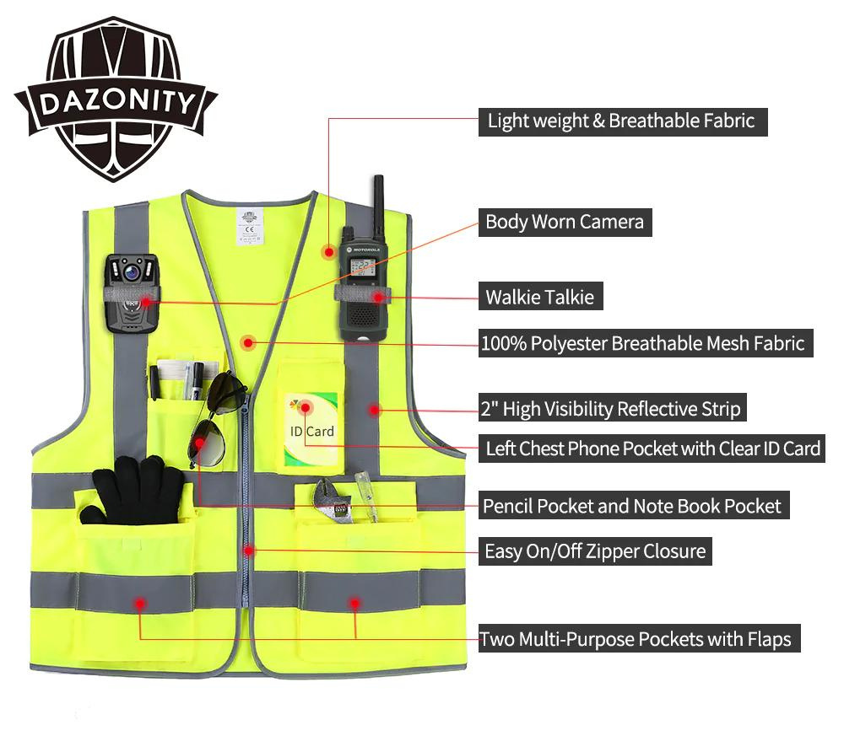
Body Camera Reflector Vest
Water-proof Fabric
High-Visibility Reflective Materials
Heavy Duty
Vivid Colors To Distinguish Various Officers
Durable Materials that won't fade upon exposure to sun

Slide 16
XVI
Benefits of Using Body Cameras
They improve police accountability and lower reports of police misconduct.
Reduce cases of bribery on our Kenyan roads.
01
03
They are a good police reform tool and have strong support from members of the public.
A smart policing in the fight against crime and as a safety measure to protect the men and women in blue during operations.
02
04

Slide 17


XVII
Thank You!
RSAK
Do you have any questions? We're always here for you.
info@roadsafetyassociationofkenya.org
+254 746 736525
DAVID KIARIE | POLICE BODY CAMERAS

